Slide 1




A barrier to global plant invasion ecology: gaps in trait availability for alien species
Matthias Grenié, Petr Pyšek, Franz Essl, Patrick Weigelt, Holger Kreft, Mark van Kleunen, Wayne Dawson, Ingolf Kühn, Helge Bruelheide, Marten Winter
Neobiota 2022 – Tuesday 13th of September 2022
@LeNematode
https://rekyt.github.io/

Slide 2
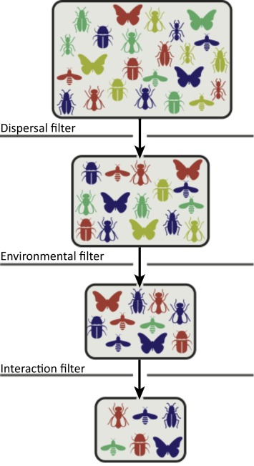
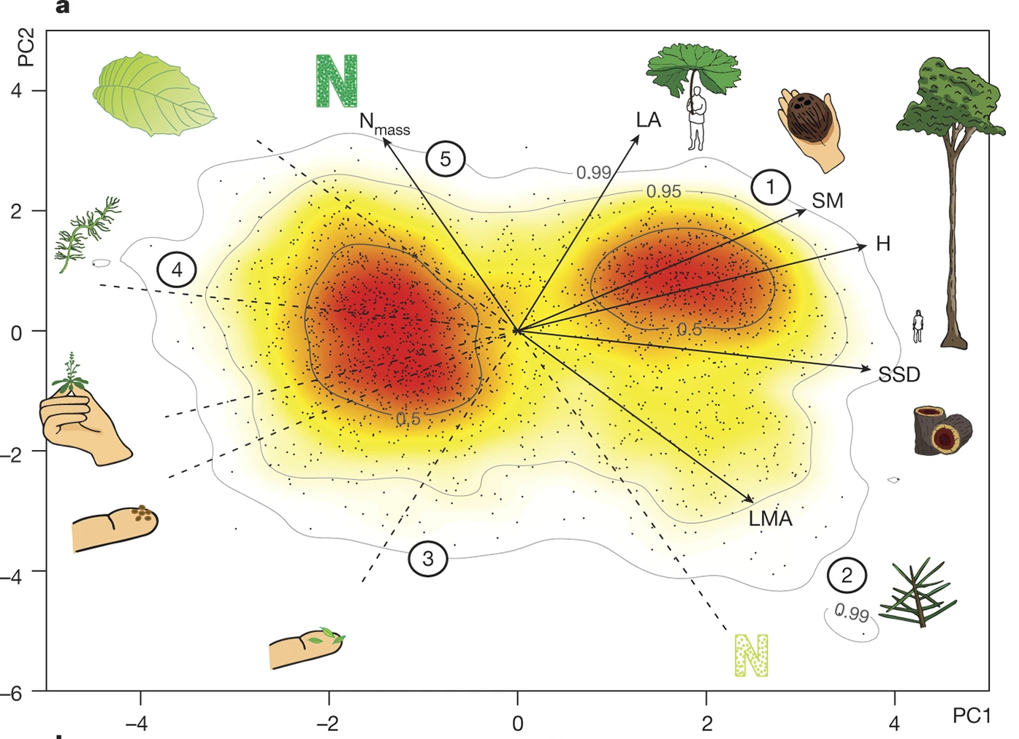
Functional Traits?
Functional traits let us gain insight to the ecology of species (Díaz et al. 2016)
Functional traits explain species relationships within communities through community ecology/coexistence theory
<numéro>

Slide 3
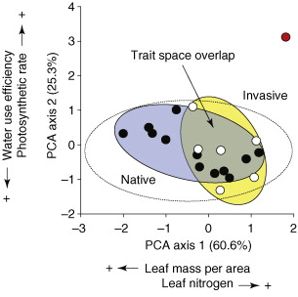
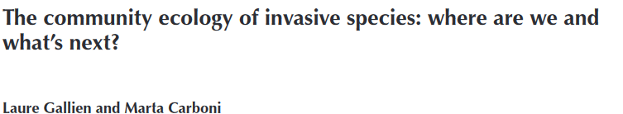
Towards the Functional Invasion Community Ecology?
Gallien & Carboni 2016
→ Importance of functional traits
Funk et al. 2008
We need massive trait data on alien species
What do we know of functional traits of alien (plant) species at global scale?
<numéro>

Slide 4




Merging Alien Species List and Global Traits
(Open) Trait Data
Alien status and distribution
Taxonomic Harmonization (Grenié et al. 2022) + Trait Harmonization + Trait Categorization
16 538 species from GloNAF → 15 490 species with at least one trait (consolidated data)
<numéro>

Slide 5
Single Trait and Trait Combinations
<numéro>

Slide 6
Most frequently measured traits
<numéro>

Slide 7
Distribution of Trait Combinations
<numéro>

Slide 8
Geographical Availability of Trait Data
<numéro>

Slide 9
Widespread and Invasive Species are better known
<numéro>

Slide 10
Going Further
<numéro>

Slide 11
Closing the trait gaps?
<numéro>

Slide 12
<numéro>

